Slide 1
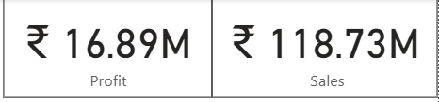
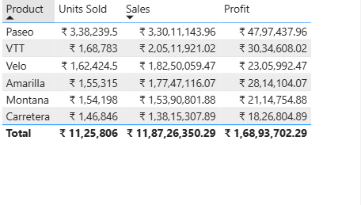
Financial Analysis
Total Profit – 16.89M
Total Sales – 118.7M
Product wise Paseo has highest number of sales with more number of units sold and high profit value

Slide 2
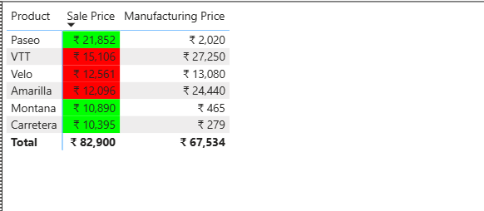
Loss and Profit
Product wise VTT, Velo and Amarilla has been sold lesser price than manufacturing price .
Paseo , Montana and Carretera are products at profit.

Slide 3
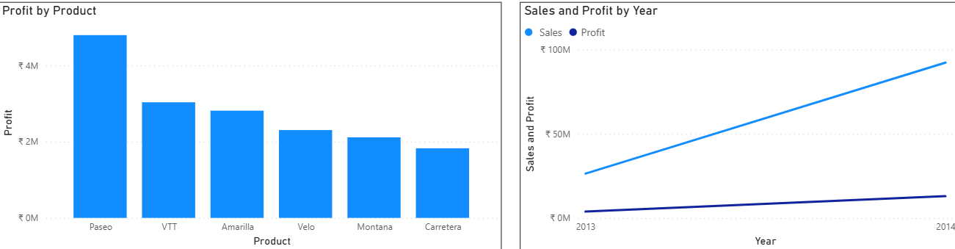
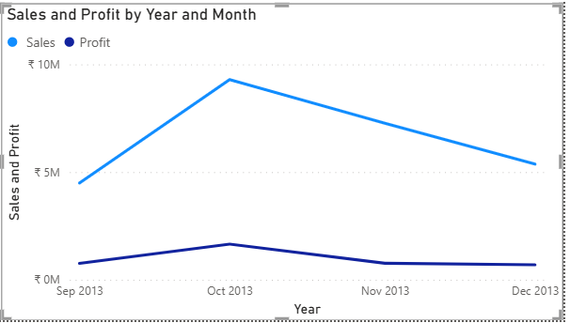
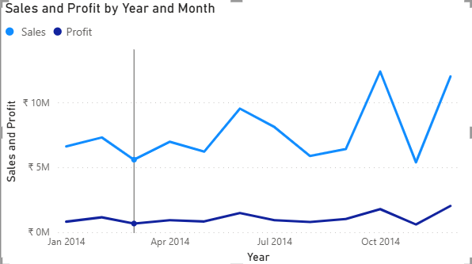
Paseo product is giving highest number of profit as compared to other products
Comparing sales and profit by Year 2014 sales and profit are higher as compared to 2013.
For the year 2013, Oct 2013 has given more sales and higher profit.
For the year 2014, Oct 2014 has given more sales and higher profit

